Slide 1
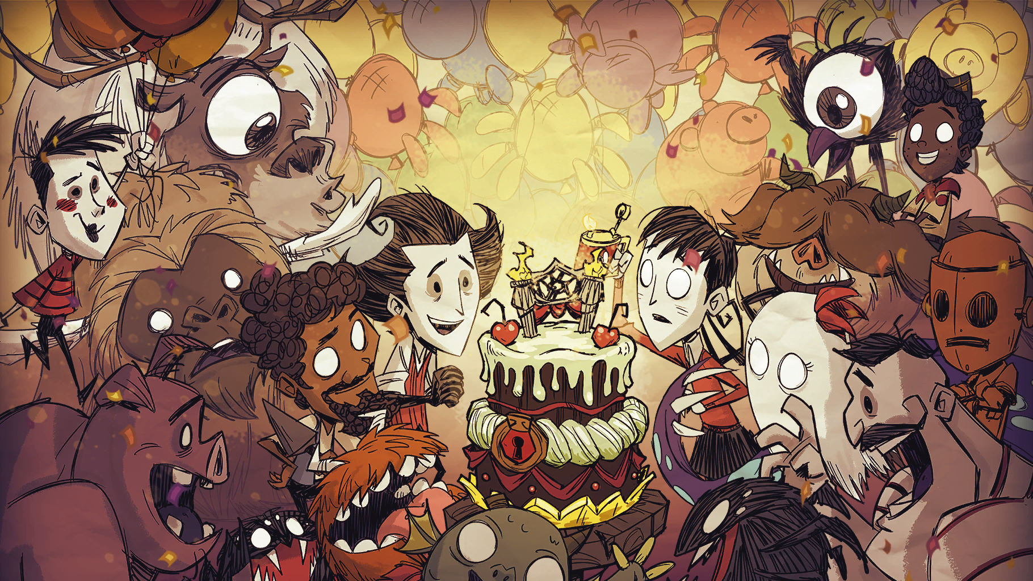

DST-GPT
Chatting with your own Don’t Starve & Don’t Starve Together Expert!

Slide 2
Outline
1. Introduction
2. Overiew of DST-GPT
3. Data Preparation
4. Framework
5. Demonstrations
6. Future Work
References

Slide 3
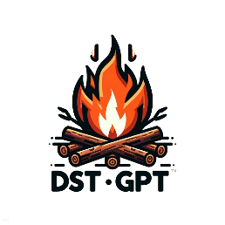
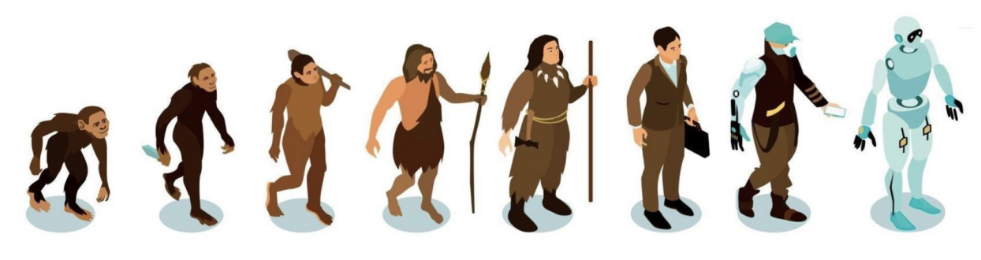
1. Introduction
Tools are extensions of human capabilities, aimed at enhancing productivity, efficiency, and problem-solving abilities. The fundamental hallmark of humanity's eventual divergence from the animal kingdom is the creation and use of tools.
——Karl Heinrich Marx
Humans have always been the primary inventors and users of tools.
Can AI(Artificial Intelligence) possess the same ability to use tools as humans?

Slide 4
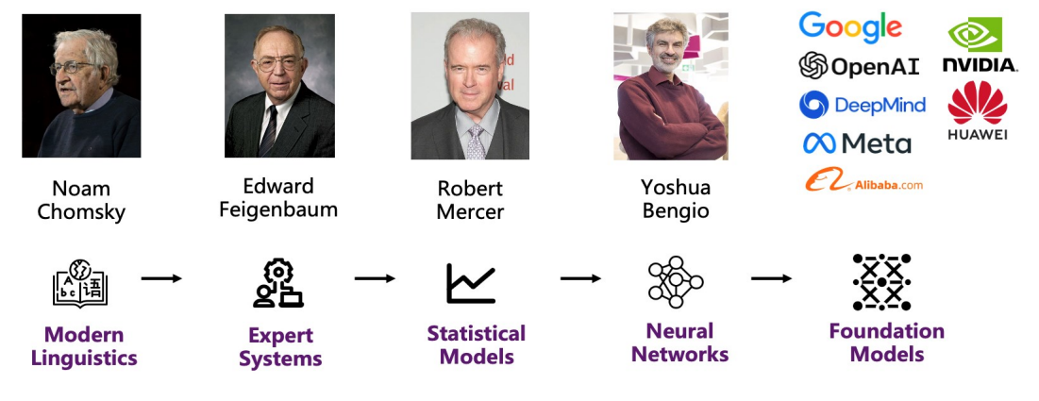
1. Introduction
Large language models(LLMs) become revolutionary tools through the following capabilities:
Rich World Knowledge
Powerful Semantic Understanding
Strong Reasoning Capabilities
Figure. Evolution of language models

Slide 5
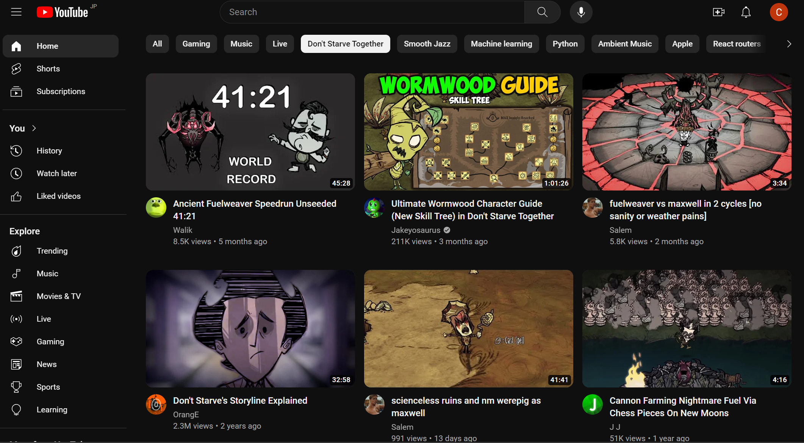



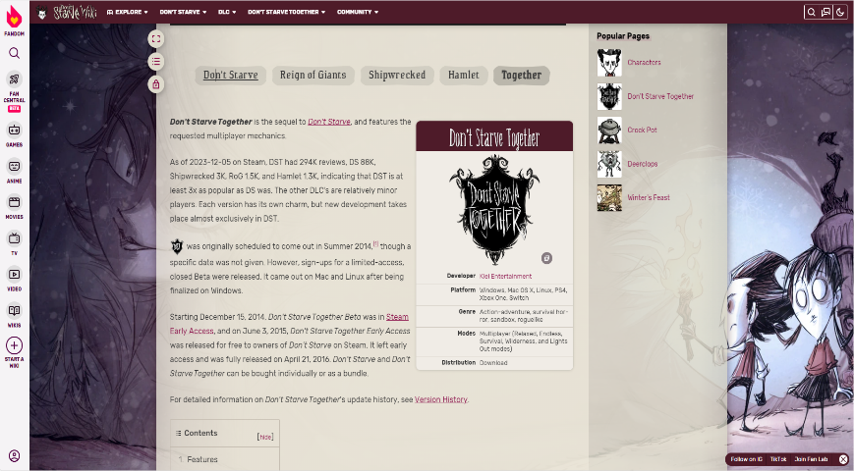
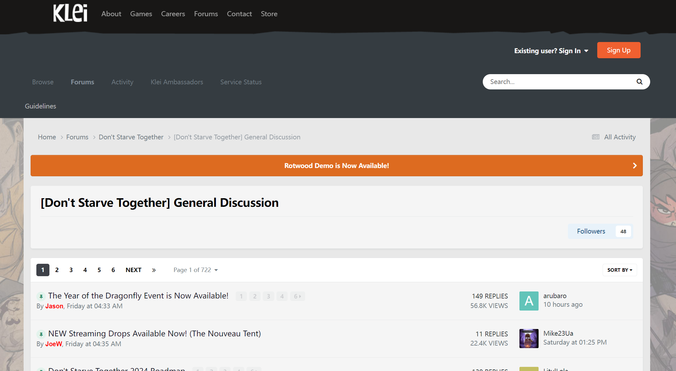

1. Introduction
For a Don’t Starve Together(DST) player, game infomation queries are time-consuming and labor-intensive. It always involves of multiple direct and redirect to find final answers.
Youtube
Reddit
Wiki Fandom
Klei Forum
Figure. Pipeline of game-realted information search

Slide 6
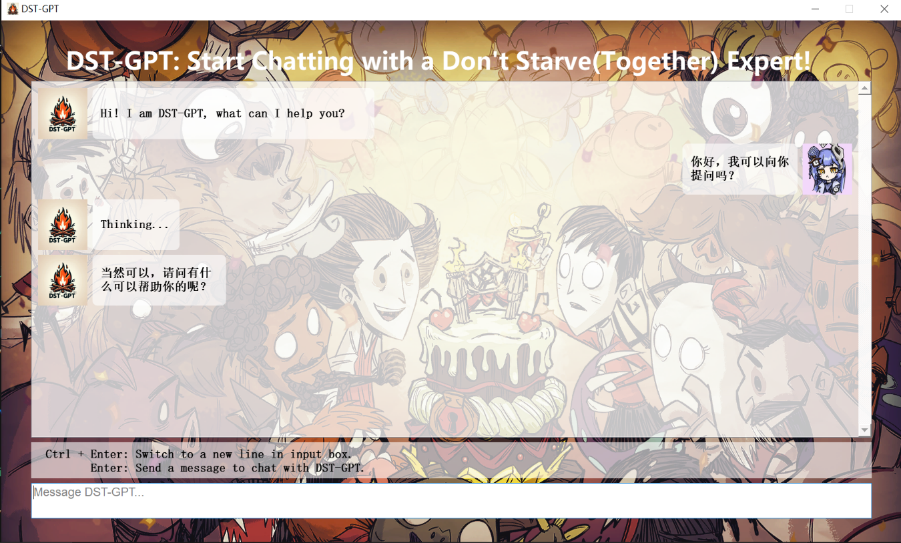
1. Introduction
Here, we introduce DST-GPT, a chatrobot based on open-source language models, which focuses on answering questions for both Don't Starve and Don't Starve Together.
A chat robot always available and polite
3A Solution
Accurate data based on solid knowledge database
Acquire a direct response to the inquiry
Figure. Chatting with DST-GPT

Slide 7
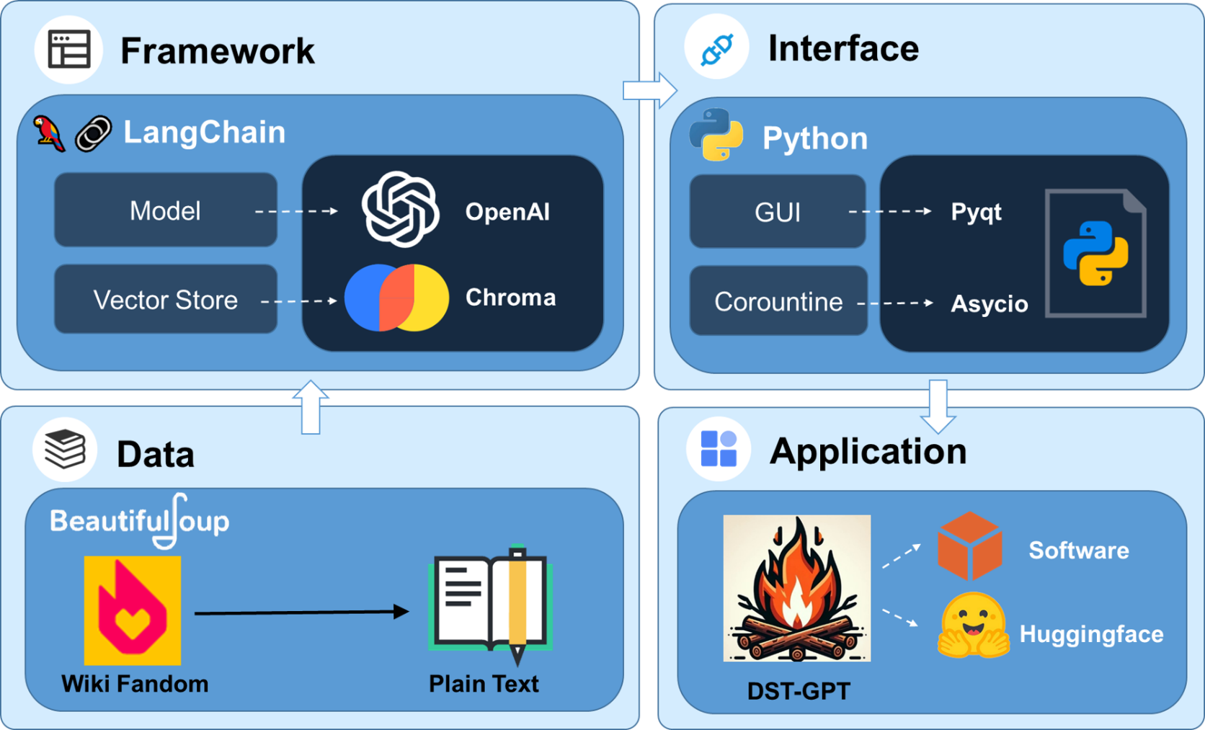
2. Overview of DST-GPT
BeautifulSoup: Webpages Crawler
LangChain: LLMs Framework
OpenAI: LLMs Core Modules
Chroma: Vectorstores
Pyqt: Graphic User Interface
Asyncio: Asynchronous Calling
Huggingface: Deployment
Figure. An overview of constructing DST-GPT

Slide 8
3. Data Preparation

Slide 9
4. Framework

Slide 10
5. Demonstrations

Slide 11
6. Future Work

Slide 12
References
Zhao, Wayne Xin, et al. "A survey of large language models." arXiv preprint arXiv:2303.18223 (2023).
Ovadia, Oded, et al. "Fine-tuning or retrieval? comparing knowledge injection in llms." arXiv preprint arXiv:2312.05934 (2023).
Gao, Yunfan, et al. "Retrieval-augmented generation for large language models: A survey." arXiv preprint arXiv:2312.10997 (2023).

